Slide 1

BRAND AWARENESS STUDY

Slide 2
Objective
A dipstick study to check brand awareness levels amongst top conglomerates / corporate groups, pre campaign launch

Slide 3
Approach
Brand Awareness Study
A quantitative study across 4 centers (Delhi, Mumbai, Hyderabad & Chennai)
30 respondents from each city
Short one page questionnaire to record their TOM, spontaneous & aided recall
Recruitment standards set as per brand TG
Recruitment & survey conducted by external research agency in Delhi, Mumbai & Hyderabad (by our own executives in Chennai)

Slide 4
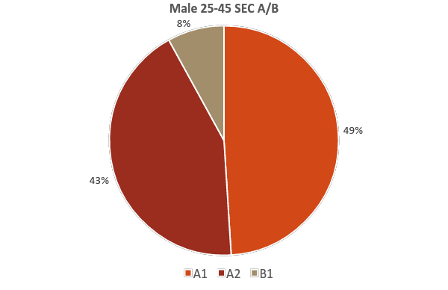
Respondents profile
PRE-CAMPAIGN STUDY

Slide 5
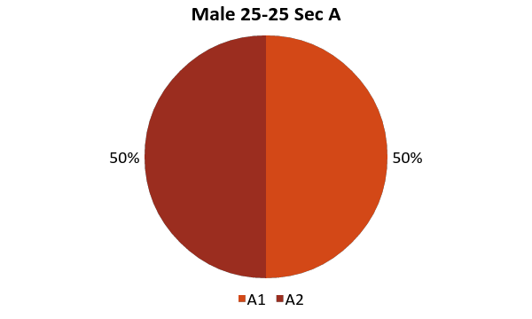
Respondents profile
POST-CAMPAIGN STUDY

Slide 6
Brand Awareness Study
Indian conglomerates / corporate Group - brand awareness
Overall
TOM
Spontaneous
Aided
Murugappa awareness
Group company association
Quality of awareness

Slide 7
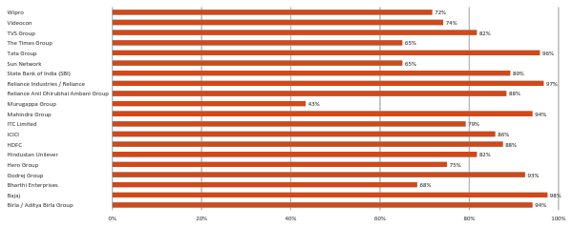
Overall Brand Awareness – 4 cities
PRE-CAMPAIGN STUDY

Slide 8
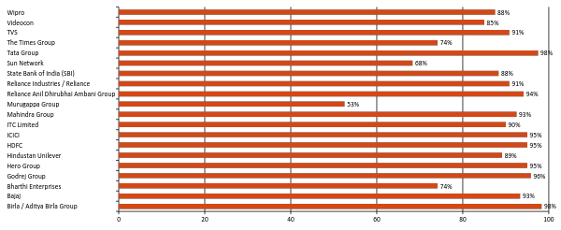
Overall Brand Awareness – 4 cities
POST-CAMPAIGN STUDY

Slide 9
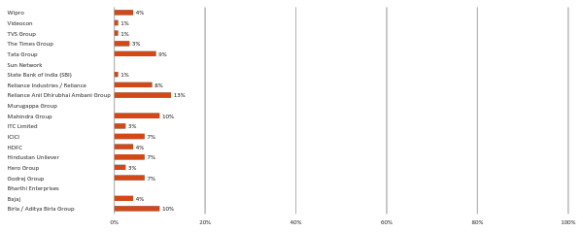
TOM – 4 cities
PRE-CAMPAIGN STUDY

Slide 10
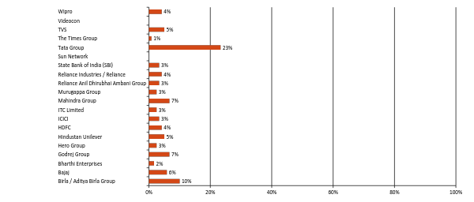
TOM – 4 cities
POST-CAMPAIGN STUDY

Slide 11
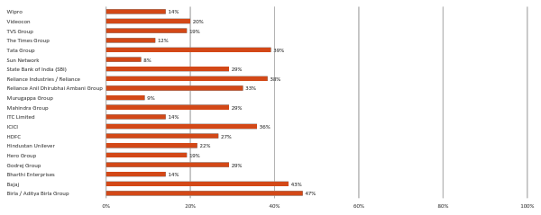
Spontaneous – 4 cities
PRE-CAMPAIGN STUDY

Slide 12
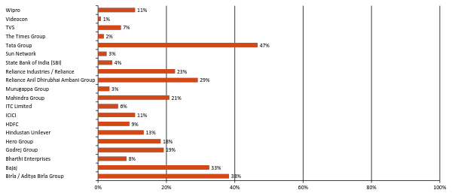
Spontaneous – 4 cities
POST-CAMPAIGN STUDY

Slide 13
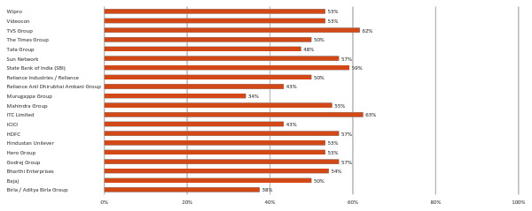
Aided – 4 cities
PRE-CAMPAIGN STUDY

Slide 14
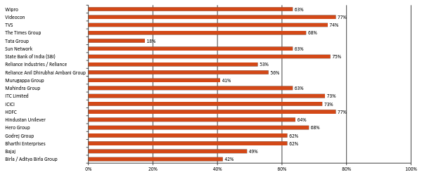
Aided – 4 cities
POST-CAMPAIGN STUDY

Slide 15
Other brands mentioned – 4 cities
PRE-CAMPAIGN STUDY
TCS
Cognizant
Infosys
Philips
HCL

Slide 16
Other brands mentioned – 4 cities
POST-CAMPAIGN STUDY
IOB
Dabur
Maruthi Suzuki
Sahara
Ashok Leyland
Future Group
Infosys
India Cements
HCL

Slide 17
Awareness of Murugappa – 4 cities
PRE-CAMPAIGN STUDY
CHENNAI
HYDERABAD
MUMBAI
DELHI
They have more than 15 companies
They come for placements in Engineering colleges.
TI Cycles & Parrys is very famous
Coromandel is from Murugappa. They are into fertilizers and cements.
It is one of the popular organization from south India doing different activities like Finance, Investment, Manufacturing etc.
It is a financial group
Coromandel belongs to Murugappa
Gives personal loan
South Indian Finance company
They are in finance sector
Education and car loan
Financial services
Heard of them. Not sure what business they are into.

Slide 18
Awareness of Murugappa – 4 cities
POST-CAMPAIGN STUDY
CHENNAI
HYDERABAD
MUMBAI
DELHI
They have many diverse companies
Head office is in Parry’s corner
TI Cycles & Parrys is very famous
Next to parry the most recalled brands are Parryware and Coromandel cements.
They came out with Madras song.
South Indian conglomerate which is into different activities like Finance, Cycles, Sugar, Insurance and cement etc.
Knew brands under them just recently
South Indian Finance company that is into education loan, investments and insurance
South Indian Finance Company / group of companies

Slide 19
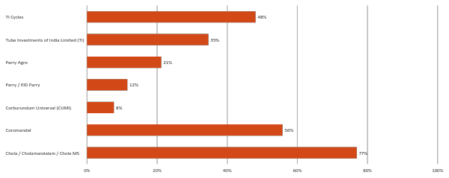
4 cities - Group companies - Overall
PRE-CAMPAIGN STUDY

Slide 20
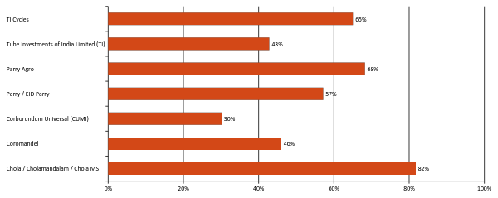
4 cities - Group companies - Overall
POST-CAMPAIGN STUDY

Slide 21
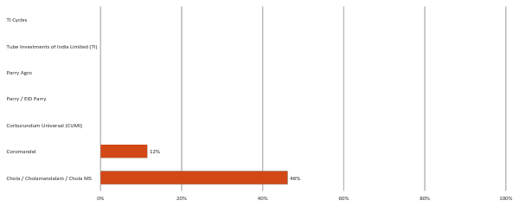
4 cities – Group Companies - TOM
PRE-CAMPAIGN STUDY

Slide 22
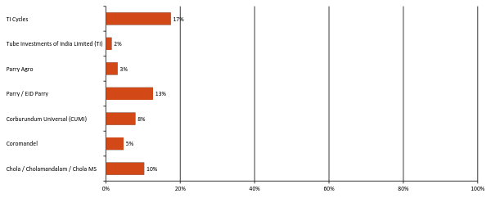
4 cities – Group Companies - TOM
POST-CAMPAIGN STUDY

Slide 23
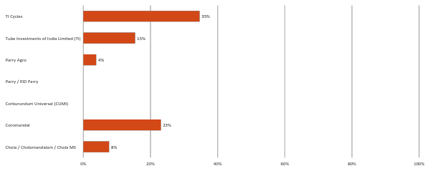
4 cities – Group Companies – Spont.
PRE-CAMPAIGN STUDY

Slide 24
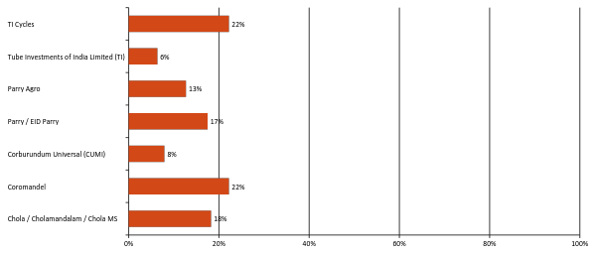
4 cities – Group Companies – Spont.
POST-CAMPAIGN STUDY

Slide 25
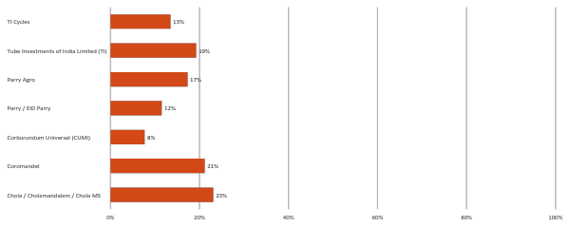
4 cities – Group Companies - Aided
PRE-CAMPAIGN STUDY

Slide 26
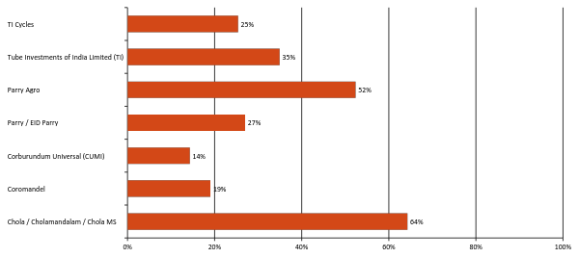
4 cities – Group Companies - Aided
POST-CAMPAIGN STUDY

Slide 27
CHENNAI

Slide 28
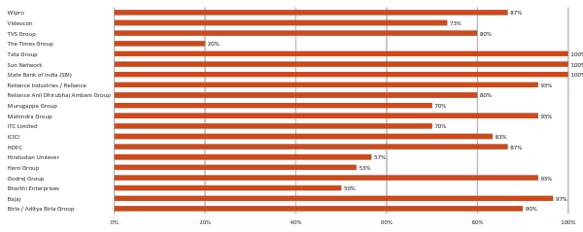
Chennai - Overall
PRE-CAMPAIGN STUDY

Slide 29
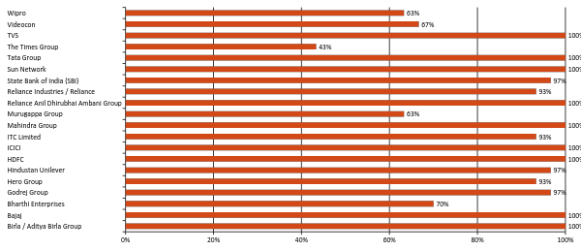
Chennai - Overall
POST-CAMPAIGN STUDY

Slide 30
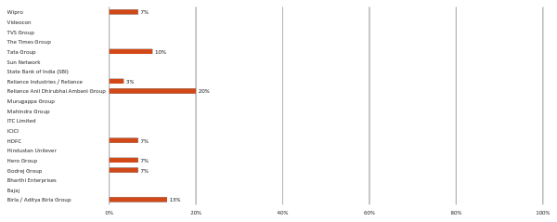
Chennai - TOM
PRE-CAMPAIGN STUDY

Slide 31
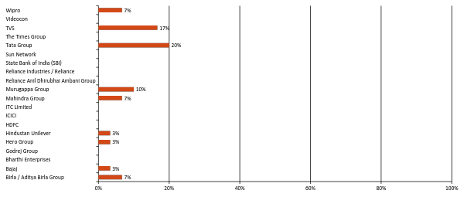
Chennai - TOM
POST-CAMPAIGN STUDY

Slide 32
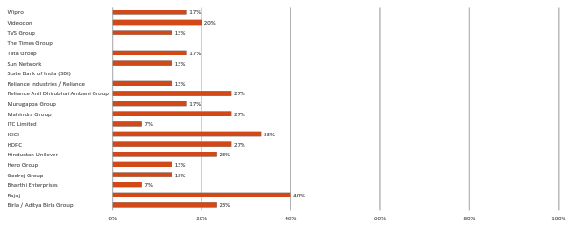
Chennai - Spontaneous
PRE-CAMPAIGN STUDY

Slide 33
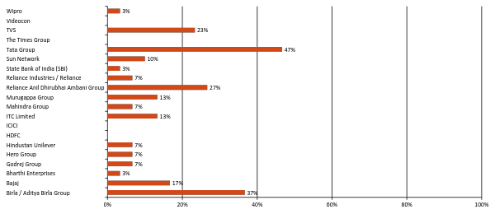
Chennai - Spontaneous
POST-CAMPAIGN STUDY

Slide 34
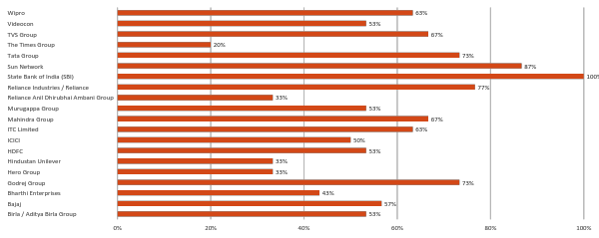
Chennai - Aided
PRE-CAMPAIGN STUDY

Slide 35
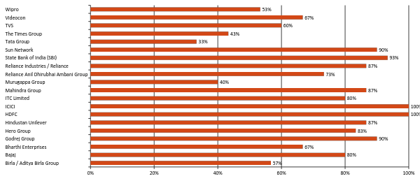
Chennai - Aided
POST-CAMPAIGN STUDY

Slide 36
Chennai - Awareness of Murugappa
PRE-CAMPAIGN STUDY
They have more than 15 companies
It is there for around 40 years. They offer banking & financial consultation
Just seen in an advertisement. They are a insurance company.
It is a management company. They come for placements in Engineering colleges.
TI Cycles & Parrys is very famous other businesses are all industrial based I think
Coromandel is from Murugappa. They are into fertilizers and cements.
Seen a music video recently.

Slide 37
Chennai - Awareness of Murugappa
POST-CAMPAIGN STUDY
Murugappa is a very old reputed company.
Hercules cycles are their product.
Many haven't seen advertisements but have known through friends or families.
They are also own colleges and hospitals also.
TI Cycles & Parrys are very famous.
Coromandel is from Murugappa. They are into fertilizers and cements.
Seen a music video recently for 375th birthday of Chennai.

Slide 38
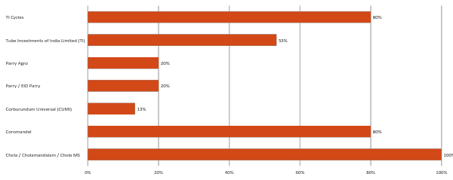
Chennai – Group companies - Overall
PRE-CAMPAIGN STUDY

Slide 39
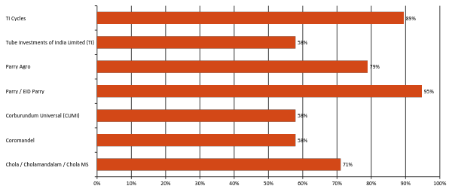
Chennai – Group companies - Overall
POST-CAMPAIGN STUDY

Slide 40
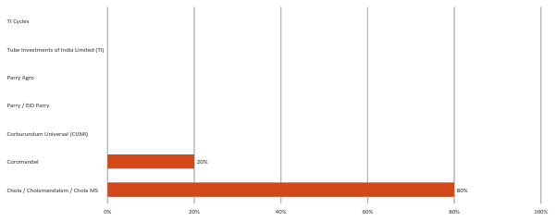
Chennai – Group Companies - TOM
PRE-CAMPAIGN STUDY

Slide 41
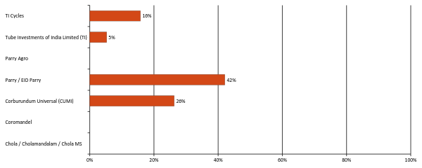
Chennai – Group Companies - TOM
POST-CAMPAIGN STUDY

Slide 42
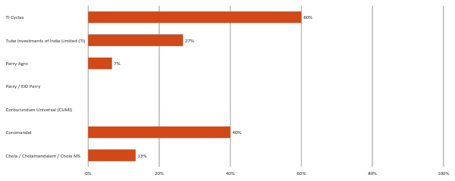
Chennai – Group Companies – Spont.
PRE-CAMPAIGN STUDY

Slide 43
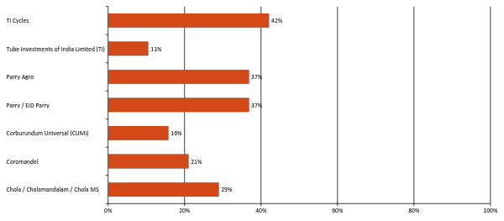
Chennai – Group Companies – Spont.
POST-CAMPAIGN STUDY

Slide 44
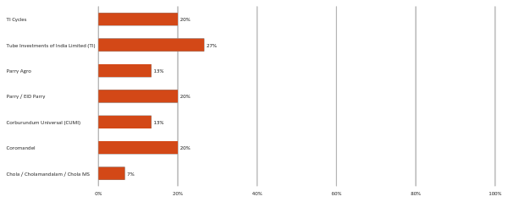
Chennai – Group Companies - Aided
PRE-CAMPAIGN STUDY

Slide 45
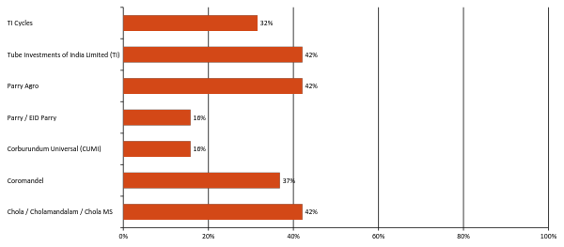
Chennai – Group Companies - Aided
POST-CAMPAIGN STUDY

Slide 46
HYDERABAD

Slide 47
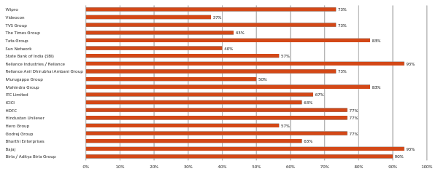
Hyderabad - Overall
PRE-CAMPAIGN STUDY

Slide 48
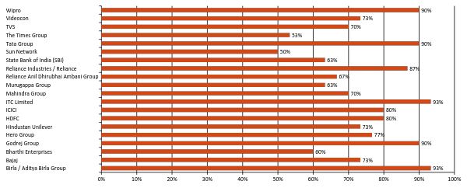
Hyderabad - Overall
POST-CAMPAIGN STUDY

Slide 49
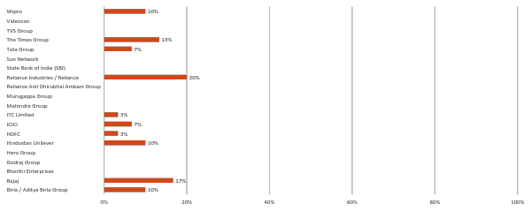
Hyderabad - TOM
PRE-CAMPAIGN STUDY

Slide 50
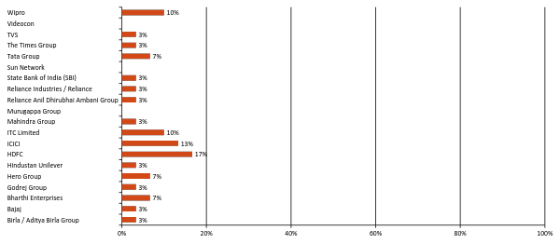
Hyderabad - TOM
POST-CAMPAIGN STUDY

Slide 51
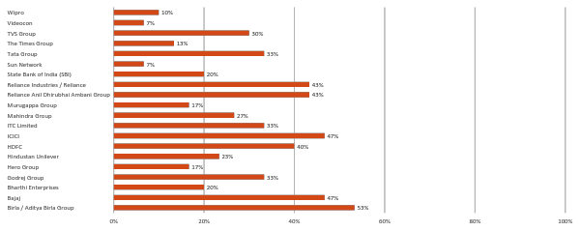
Hyderabad - Spontaneous
PRE-CAMPAIGN STUDY

Slide 52
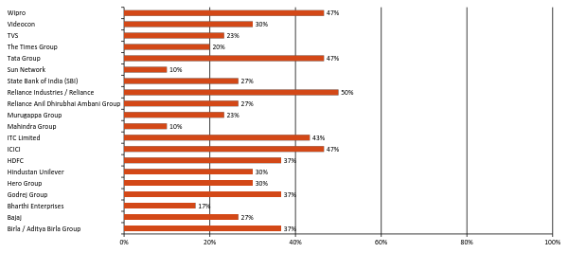
Hyderabad - Spontaneous
POST-CAMPAIGN STUDY

Slide 53
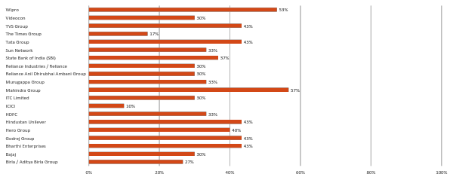
Hyderabad - Aided
PRE-CAMPAIGN STUDY

Slide 54
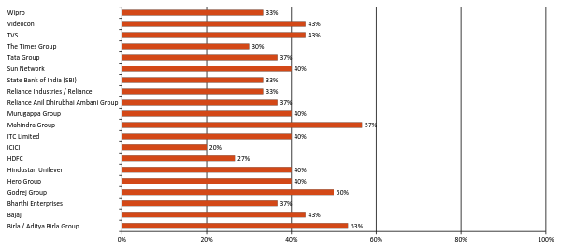
Hyderabad - Aided
POST-CAMPAIGN STUDY

Slide 55
Hyderabad - Awareness of Murugappa
PRE-CAMPAIGN STUDY
It is one of the popular organization from south India doing different activities like Finance, Investment, Manufacturing etc.
It is a financial group
Coromandel belongs to Murugappa
It is a group of companies manufacturing cycles, tubes and fertilizers
They are leading in finance and cycle manufacture
Chola insurance belongs to Murugappa
Murugappa group has multiple businesses like fisheries, oil etc.

Slide 56
Hyderabad - Awareness of Murugappa
POST-CAMPAIGN STUDY
Murugappa is a south Indian diversified company which is into finance, agriculture and manufacturing.
They own Hercules and BSA brand of cycles
Coromandel cements and fertilizers belongs to Murugappa
Chola insurance and cholamandalam finance belongs to Murugappa
Came to know about the brands they own recently. Knew only the products till then.

Slide 57
Hyderabad – Group companies - Overall
PRE-CAMPAIGN STUDY

Slide 58
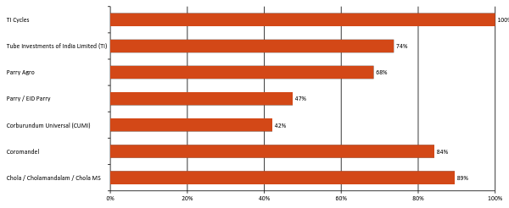
Hyderabad – Group companies - Overall
POST-CAMPAIGN STUDY

Slide 59
Hyderabad – Group Companies - TOM
PRE-CAMPAIGN STUDY

Slide 60
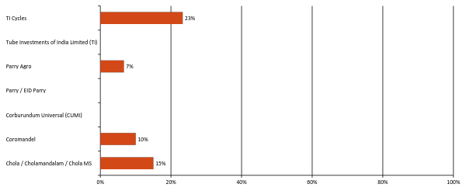
Hyderabad – Group Companies - TOM
POST-CAMPAIGN STUDY

Slide 61
Hyderabad – Group Companies – Spont.
PRE-CAMPAIGN STUDY

Slide 62
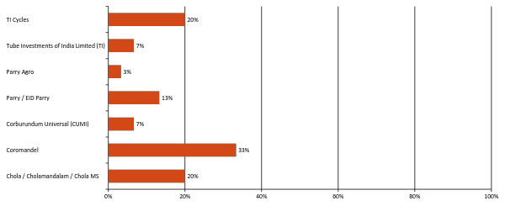
Hyderabad – Group Companies – Spont.
POST-CAMPAIGN STUDY

Slide 63
Hyderabad – Group Companies - Aided
PRE-CAMPAIGN STUDY

Slide 64
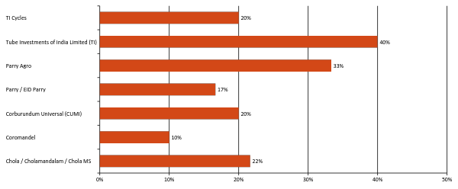
Hyderabad – Group Companies - Aided
POST-CAMPAIGN STUDY

Slide 65
MUMBAI

Slide 66
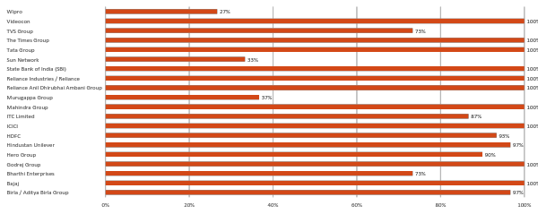
Mumbai - Overall
PRE-CAMPAIGN STUDY

Slide 67
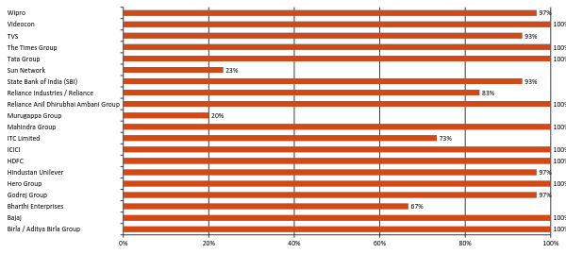
Mumbai - Overall
POST-CAMPAIGN STUDY

Slide 68
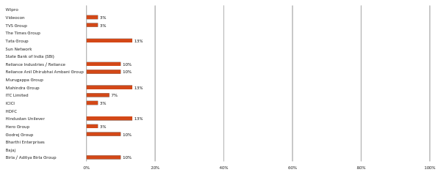
Mumbai - TOM
PRE-CAMPAIGN STUDY

Slide 69
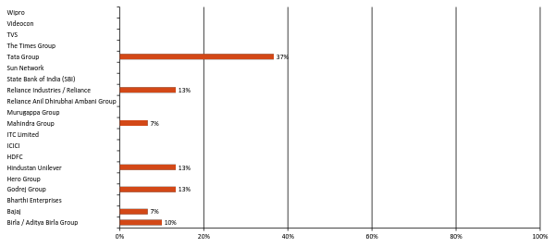
Mumbai - TOM
POST-CAMPAIGN STUDY

Slide 70

Mumbai - Spontaneous
PRE-CAMPAIGN STUDY

Slide 71

Mumbai - Spontaneous
POST-CAMPAIGN STUDY

Slide 72

Mumbai - Aided
PRE-CAMPAIGN STUDY

Slide 73

Mumbai - Aided
POST-CAMPAIGN STUDY

Slide 74
Mumbai - Awareness of Murugappa
PRE-CAMPAIGN STUDY
Offers educational and vehicle loan
Gives personal loan
South Indian Finance company
Some insurance plan and overseas travel plan
They give loans and cater to a wide range of products
They give finance – loan for car and education
They are in the finance sector

Slide 75
Mumbai - Awareness of Murugappa
POST-CAMPAIGN STUDY
Not available

Slide 76

Mumbai – Group companies - Overall
PRE-CAMPAIGN STUDY

Slide 77

Mumbai – Group companies - Overall
POST-CAMPAIGN STUDY

Slide 78
DELHI

Slide 79

Delhi - Overall
PRE-CAMPAIGN STUDY

Slide 80

Delhi - Overall
POST-CAMPAIGN STUDY

Slide 81

Delhi - TOM
PRE-CAMPAIGN STUDY

Slide 82

Delhi - TOM
POST-CAMPAIGN STUDY

Slide 83

Delhi - Spontaneous
PRE-CAMPAIGN STUDY

Slide 84

Delhi - Spontaneous
POST-CAMPAIGN STUDY

Slide 85

Delhi - Aided
PRE-CAMPAIGN STUDY

Slide 86

Delhi - Aided
POST-CAMPAIGN STUDY

Slide 87
Delhi - Awareness of Murugappa
PRE-CAMPAIGN STUDY
Financial services
Heard of them. Not sure what business they are into.

Slide 88
Delhi - Awareness of Murugappa
POST-CAMPAIGN STUDY
A south Indian finance company

Slide 89

Delhi – Group companies - Overall
PRE-CAMPAIGN STUDY

Slide 90

Delhi – Group companies - Overall
POST-CAMPAIGN STUDY

Slide 91
Key takeouts
PRE-CAMPAIGN STUDY
Overall awareness of Murugappa group at 43%
Cholamandalam / Chola is the most associated group company. Could also owe to the fact that Chola’s campaign was running at the time of the survey.
While TOM or Spontaneous response is not the criteria, we should look at improving the Aided brand awareness scores – through the year visibility initiatives
Concentrate on promoting association with consumer interacting business units first followed by B2B businesses. This will improve aided awareness scores amongst TG as they see/ interact with these businesses on a day-to-day basis

Slide 92
Key takeouts
POST-CAMPAIGN STUDY
Overall awareness of Murugappa group has raised to 53% from 43%.

Slide 93
THANK YOU

